Slide 1
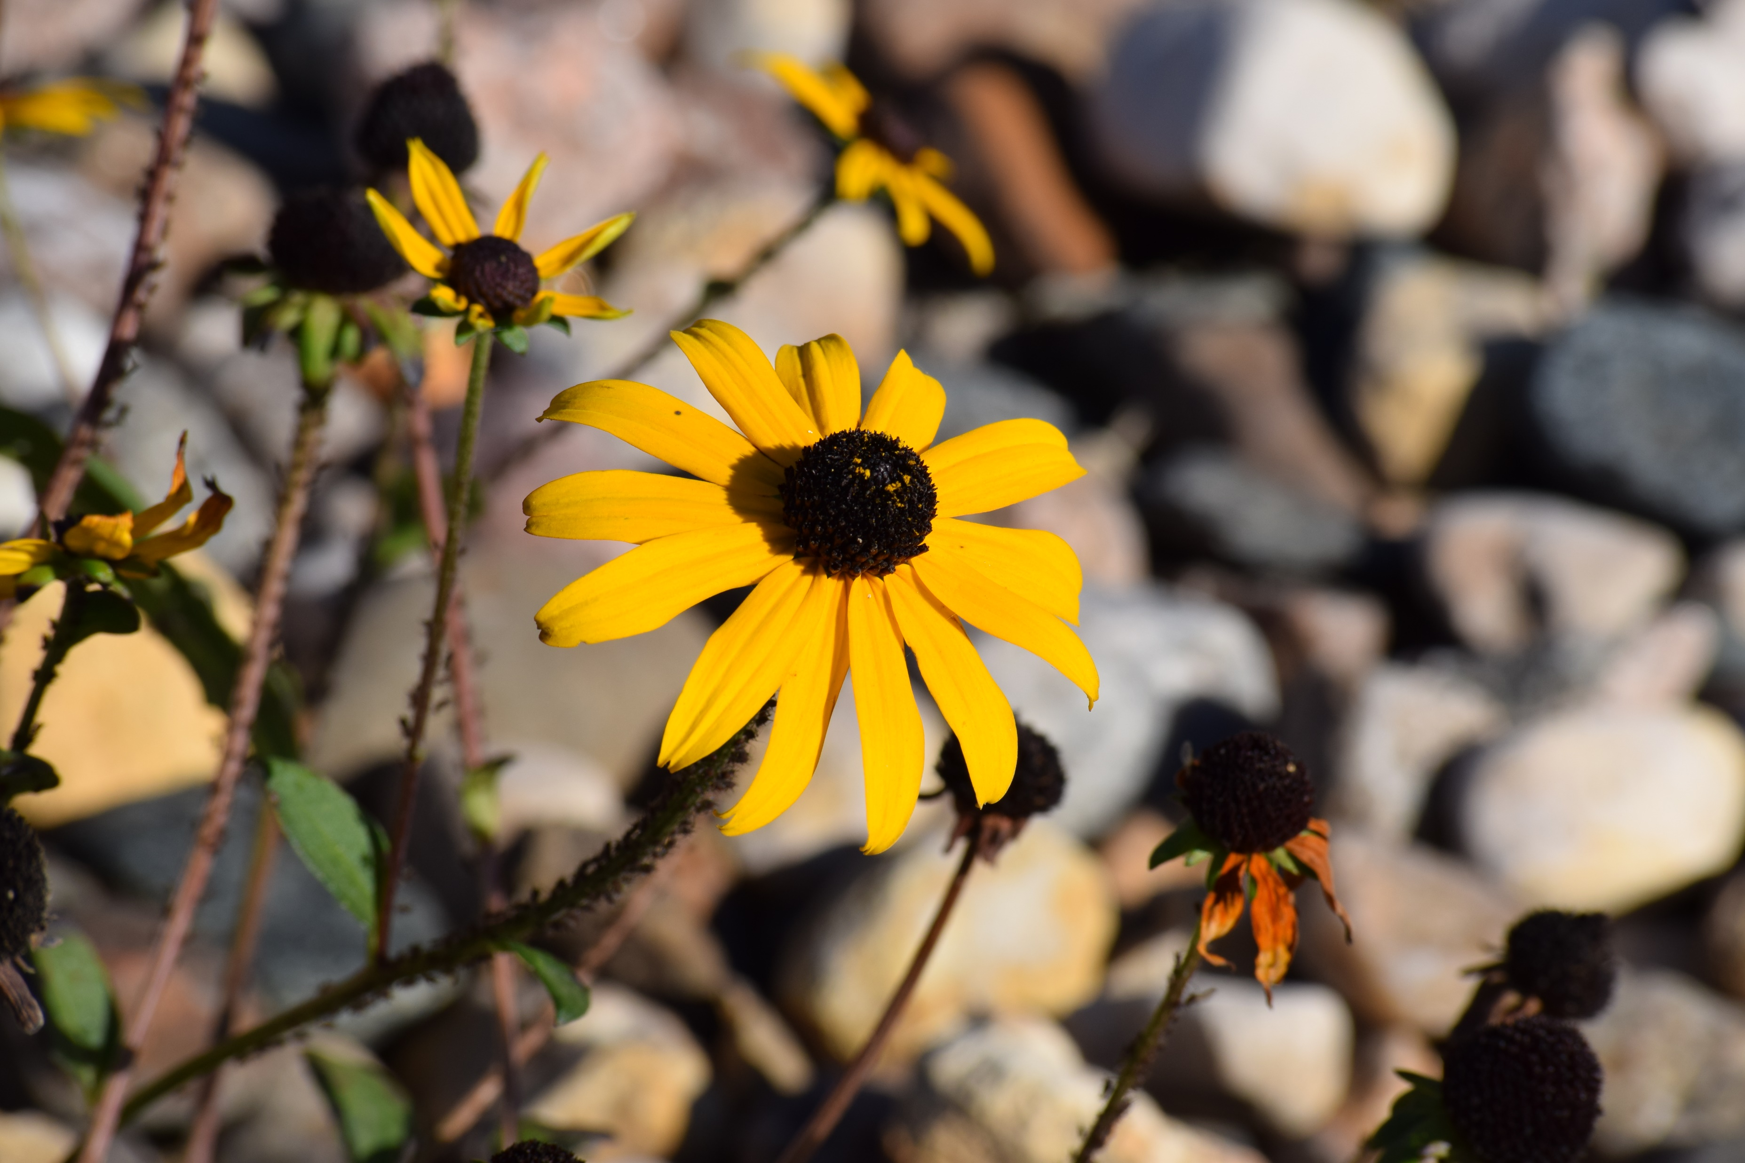
Please download Blender

Slide 2
Please draw the flower.

Slide 3
Please draw the flower.

Slide 4



Slide 5
